Slide 1
Motion in Two and Three Dimensions

Slide 2
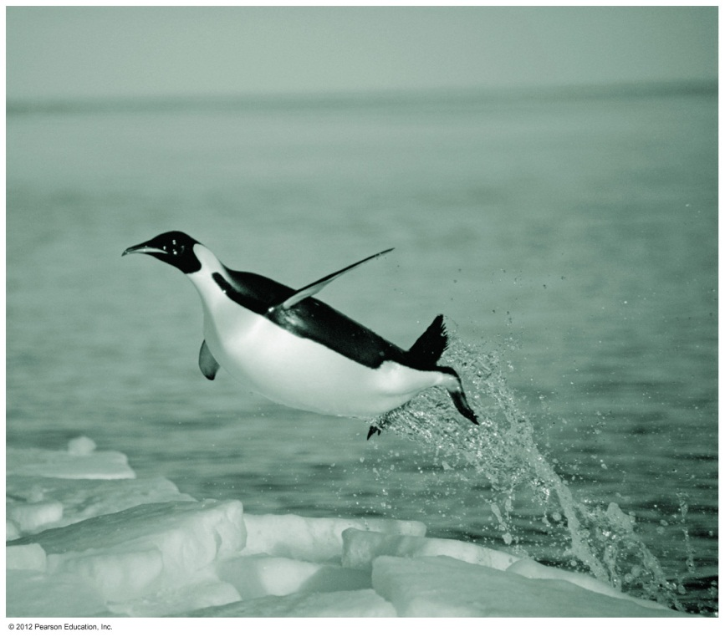
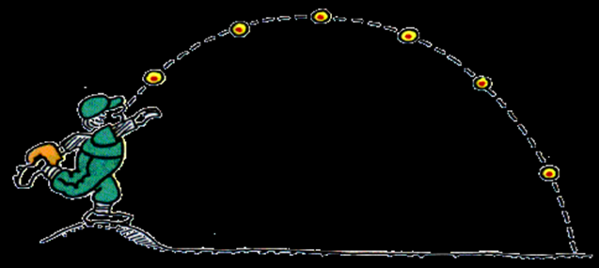
In this lecture you’ll learn
To describe position, velocity, and acceleration in three-dimensional space using the language of vectors
To manipulate vectors algebraically
To transform velocities to different reference frames
To solve problems involving constant acceleration in two dimensions
Including projectile motion due to the constant acceleration of gravity near Earth’s surface
To evaluate acceleration in circular motion
y
x

Slide 3
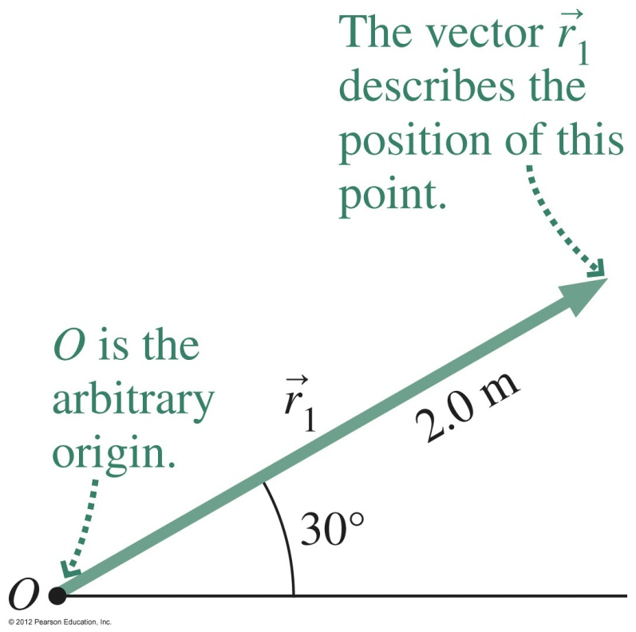
Vectors
A vector is a quantity that has both magnitude and direction.
In two dimensions it takes two numbers to specify a vector.
In three dimensions it takes three numbers.
A vector can be represented by an arrow whose length corresponds to the vector’s magnitude.
Position is a vector quantity.
An object’s position is specified by giving its distance from an origin and its direction relative to an axis.
Here describes a point 2.0 m from the origin at a 30˚ angle to the axis.

Slide 4
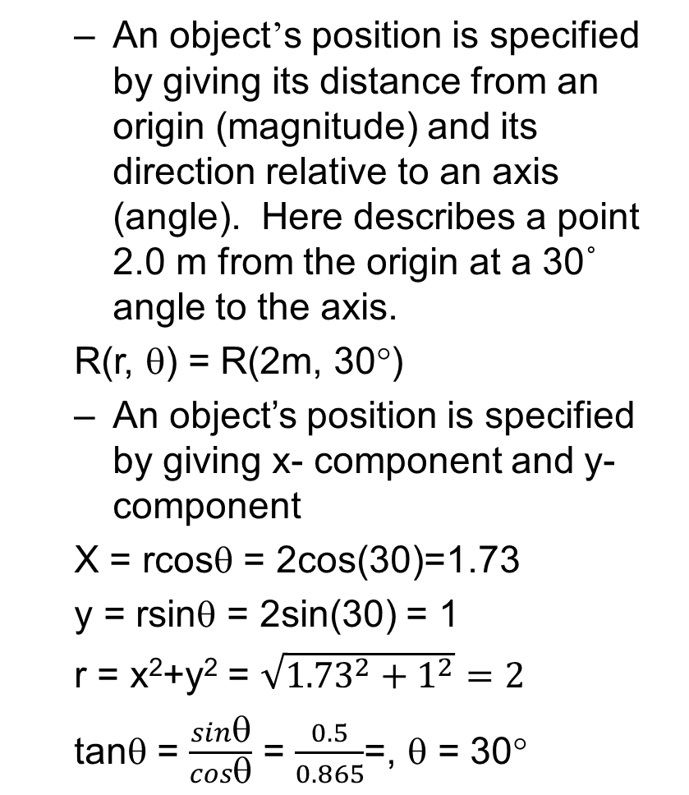
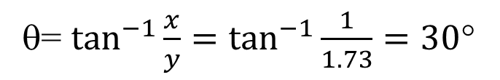
Vector Components--position

Slide 5
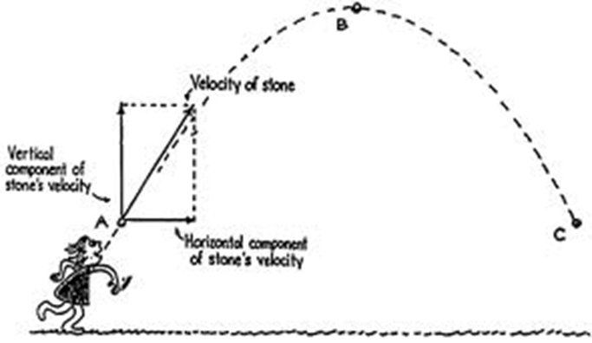
Vector Components--Velocity

Slide 6
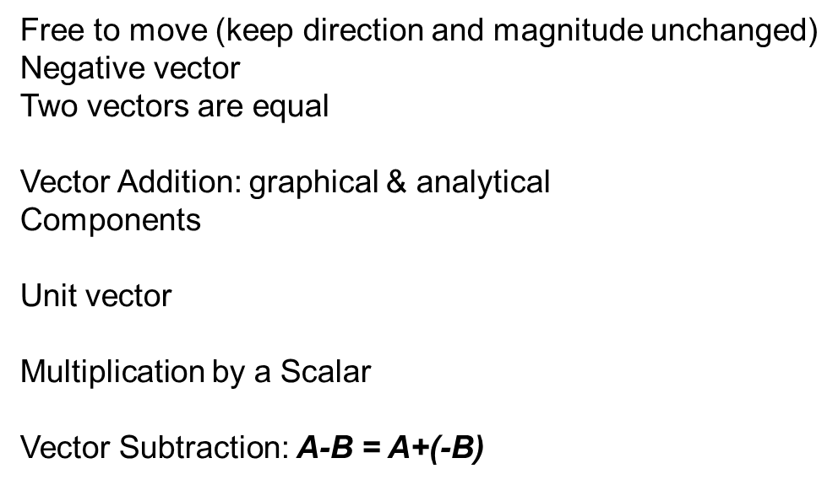
Properties of Vectors

Slide 7
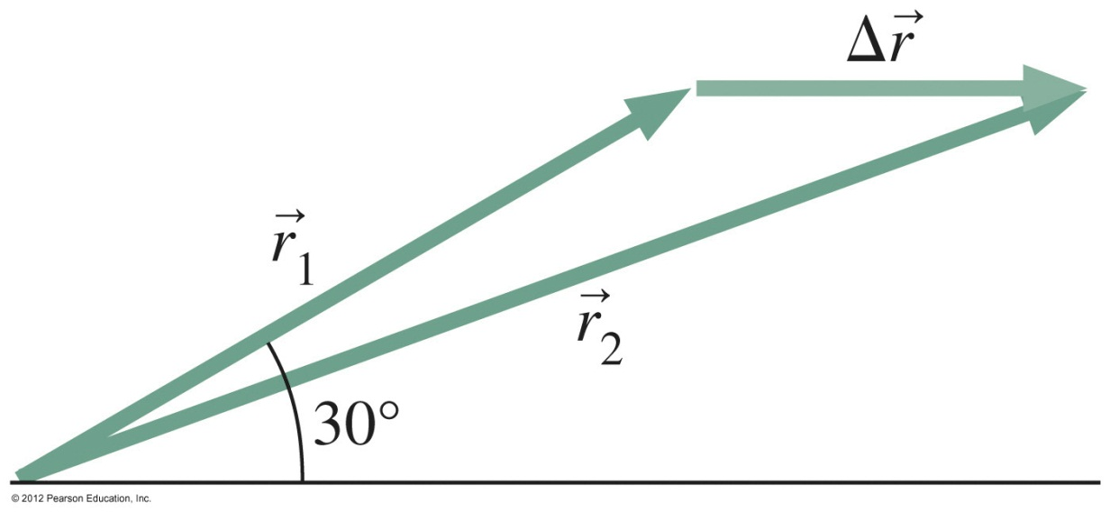
Adding Vectors
To add vectors graphically, place the tail of the first vector at the head of the second.
Their sum is then the vector from the tail of the first vector to the head of the second.
Here is the sum of and .

Slide 8

Vector Addition: Example
v_{B},Boat
v_{F}, Flow

Slide 9
Vector Addition: Example
Boat
Flow

Slide 10
Vector Addition: Example
Boat
v_{R}=v_{B}+v_{F}
Flow

Slide 11
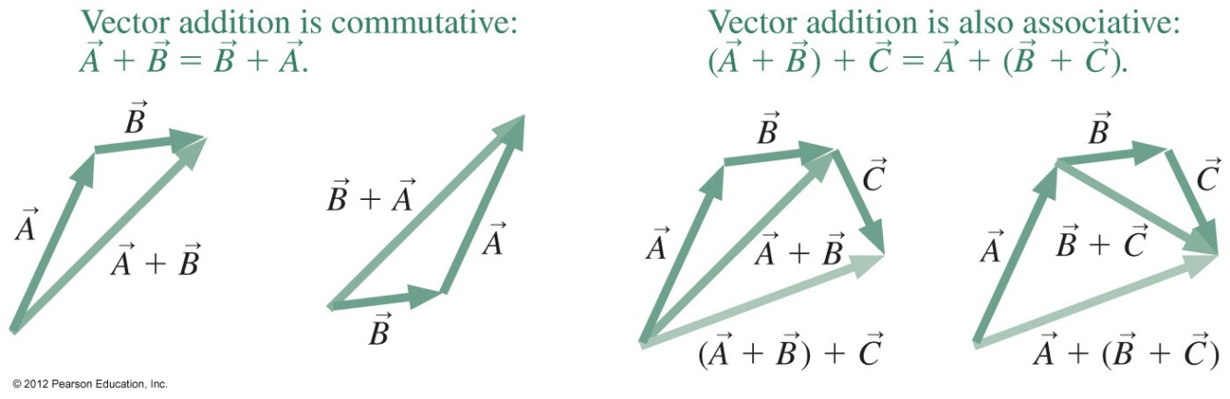
Vector Arithmetic
To multiply a vector by a scalar, multiply the vector’s magnitude by the scalar.
For a positive scalar the direction is unchanged.
For a negative scalar the direction reverses.
To subtract vectors, add the negative of the second vector to the first:
Vector arithmetic is commutative and associative:

Slide 12
Vector Addition: Graphic & Analytic methods
B_{y}
B
B_{x}
R_{y}
A_{y}
A
R
θ
A_{x}
R_{x}
Graphic Method Analytic Method

Slide 13
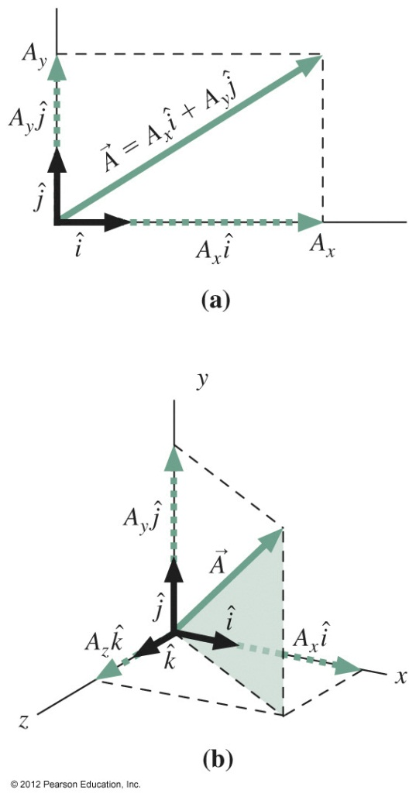
Unit Vectors
Unit vectors have magnitude 1, no units, and point along the coordinate axes.
They’re used to specify direction in compact mathematical representations of vectors.
Unit vectors in the x, y, and z directions are designated
Any vector in two dimensions can be written as a linear combination of
Any vector in three dimensions can be written as a linear combination of

Slide 14
Vector Arithmetic with Unit Vectors
To add vectors, add the individual components:
, then
Similarly,
To multiply by a scalar, distribute the scalar; that is, multiply the individual components by the scalar:

Slide 15
Velocity and Acceleration Vectors
Velocity is the rate of change of position.
The average velocity over a time interval ∆t is the change in the position vector divided by the time.
Here dividing by ∆t means multiplying by the scalar 1/∆t:
Instantaneous velocity is the time derivative of position:
Acceleration is the rate of change of velocity:

Slide 16
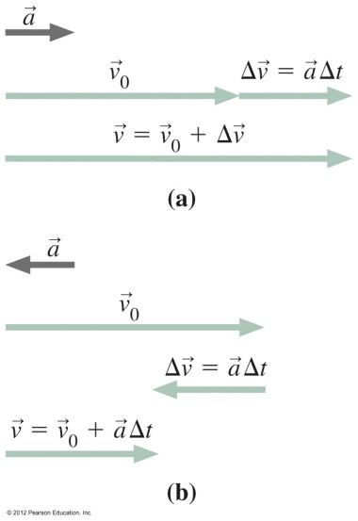
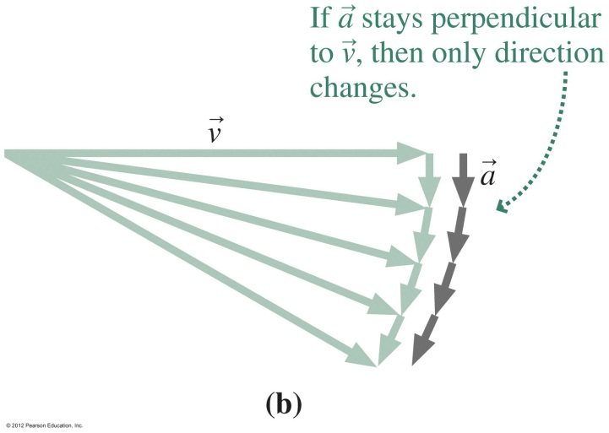
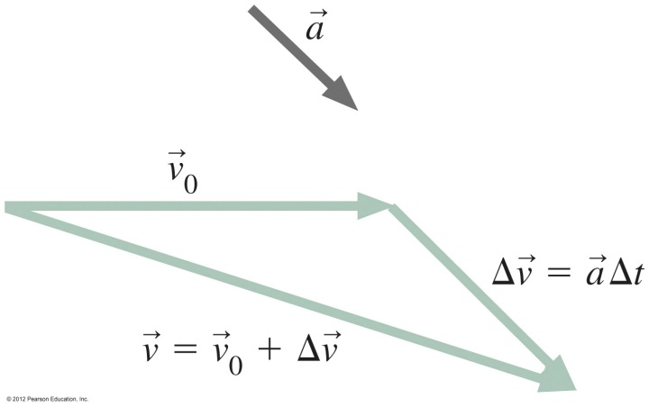
Velocity and Acceleration in Two Dimensions
An acceleration acting for time ∆t produces a velocity change
The change adds vectorially to give the new velocity:
The new velocity depends on the magnitude of the acceleration as well as its direction:

Slide 17
Kinematic Equations
Both v and a can be projected to x and y components
The kinematic equations will be good on both components

Slide 18
Projectile Motion
Motion under the influence of gravity near Earth’s surface has essentially constant acceleration whose magnitude is g = 9.8 m/s², and whose direction is downward.
Such motion is called projectile motion.
y
v₀
α
R
x

Slide 19
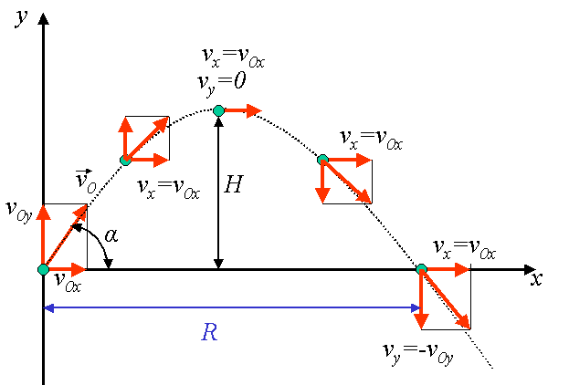
Projectile Motion

Slide 20
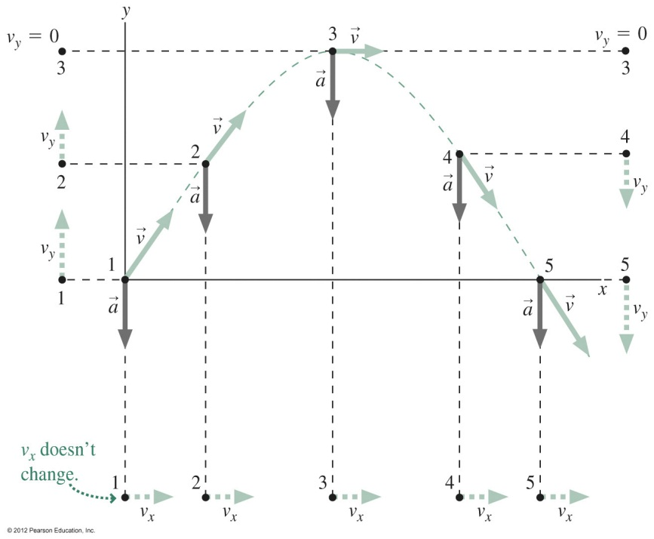
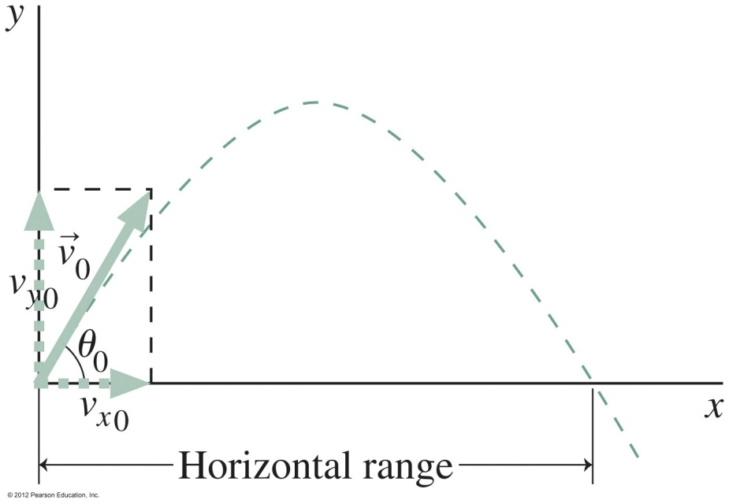
Projectile Trajectories
The trajectory of an object in projectile motion is a parabola, unless the object has no horizontal component of motion.
Horizontal motion is unchanged, while vertical motion undergoes downward acceleration:
Equation for the trajectory:

Slide 21
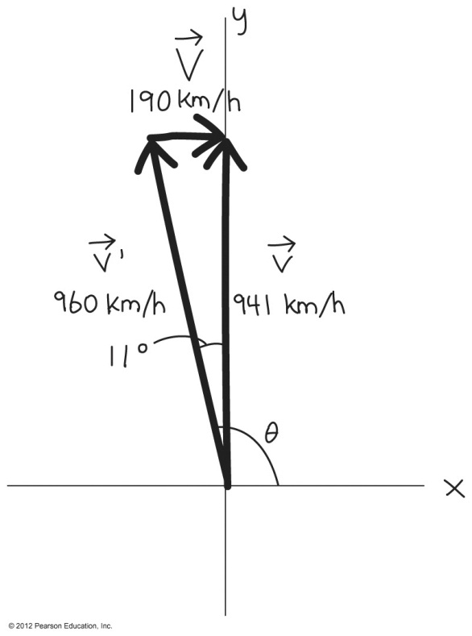
Relative Motion
An object moves with velocity relative to one frame of reference.
That frame moves at relative to a second reference frame.
Then the velocity of the object relative to the second frame is
Example:
A jetliner flies at 960 km/h relative to the air, heading northward. There’s a wind blowing eastward at 190 km/h. In what direction should the plane fly?
The vector diagram identifies the quantities in the equation, and shows that the angle is 11°.

Slide 22
Constant Acceleration
With constant acceleration, the equations for one-dimensional motion apply independently in each direction.
The equations take a compact form in vector notation.
Each equation stands for two or three separate equations.
For example, in two dimensions, the x- and y-components of the position vector can be written as

Slide 23
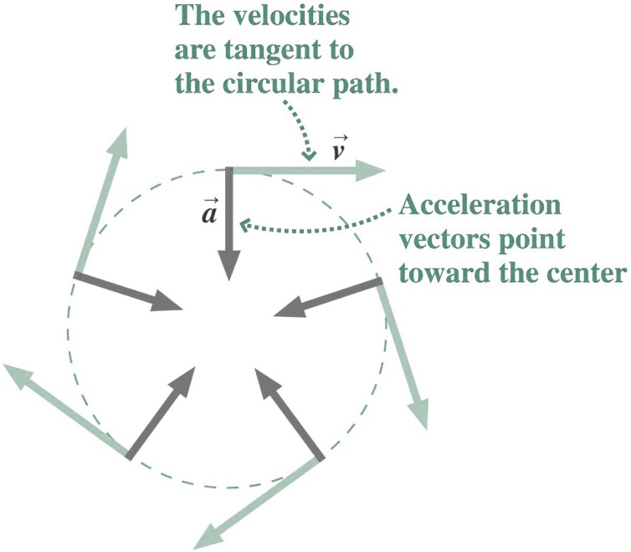
Uniform Circular Motion
When an object moves in a circular path of radius r at constant speed v, its acceleration has magnitude
The acceleration vector points toward the center of the circle.
Since the direction of the acceleration keeps changing, this is not constant acceleration.
Constant acceleration in two dimensions implies a parabolic trajectory.

Slide 24
Uniform Circular Motion—Derivation
v₂
Direction points to the center
Magnitude
v₁
R₂
R₁

Slide 25
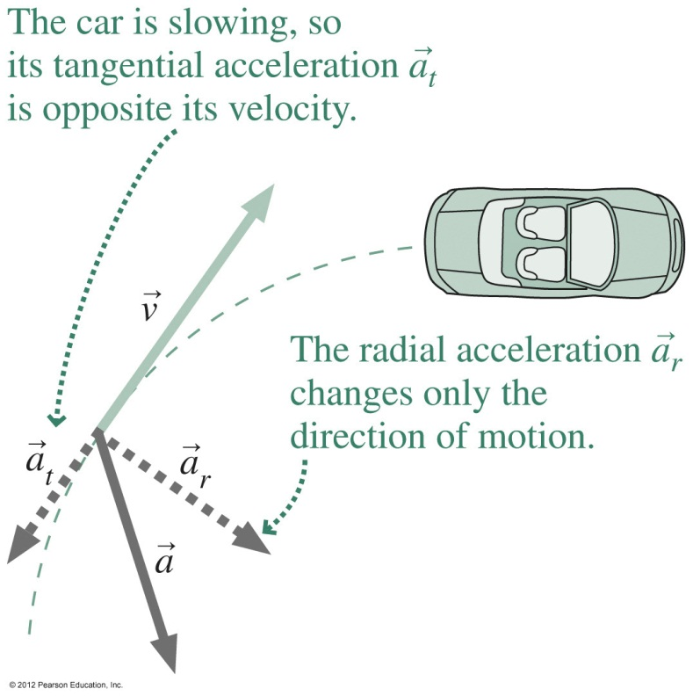
Nonuniform Circular Motion
In nonuniform circular motion, speed and path radius can both change.
The acceleration has both radial and tangential components:
is perpendicular to while is tangential to .
The figure shows a car braking as it rounds a curve.

Slide 26
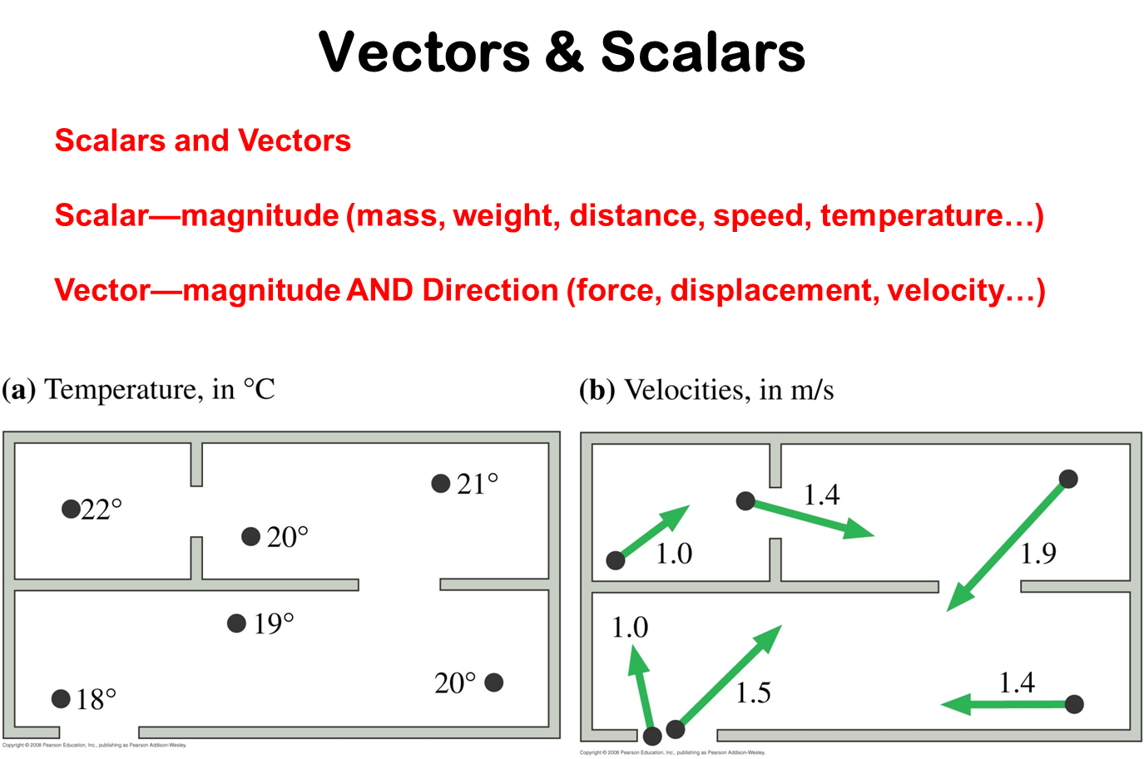
Summary

Slide 27

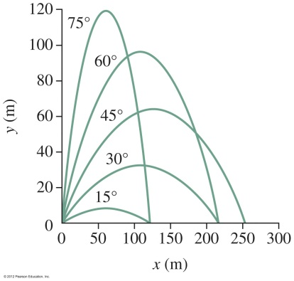
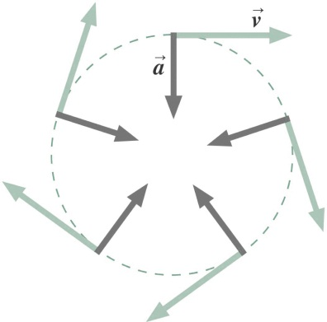
Summary
In two and three dimensions, position, velocity, and acceleration become vector quantities.
Velocity is the rate of change of position:
Acceleration is the rate of change of velocity:
In general, acceleration changes both the magnitude and direction of the velocity.
Projectile motion results from the acceleration of gravity.
In uniform circular motion, the acceleration has magnitude v²/r and points toward the center of the circular path.

Slide 28
Practice—Vector Addition
An airplane undergoes the following displacements: First, it flies 66 km in a direction 30° east of north. Next, it flies 49 km due south. Finally, it flies 100 km 30° north of west. Using vector components, determine how far the airplane ends and at what direction?

Slide 29
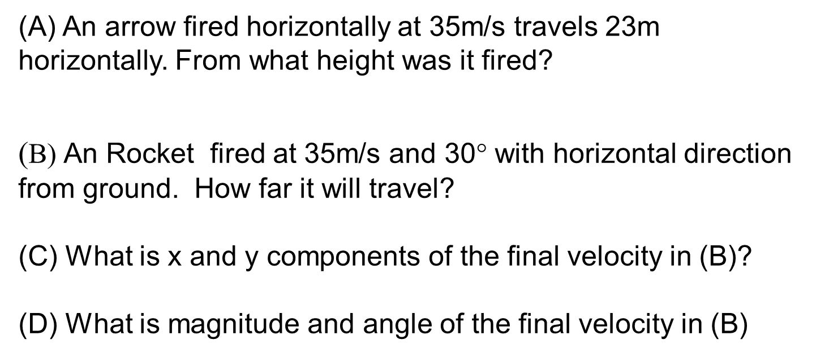
Practice-projectile motion

Slide 30
Practice
There are two vectors A and B. If A - B = 3i – 4j, then B - A is
A) 3i – 4j B) -3i + 4j C) 3i + 4j D) -3i – 4j E) 0
A toy rocket is launched vertically from ground level (y = 0 m), at time t = 0.0 s. The rocket engine provides constant upward acceleration during the burn phase. At the instant of engine burnout, the rocket has risen to 93 m and acquired a velocity of 50 m/s. Find the time interval of the process.
A) 3.0 s B) 3.3 s C) 4.1 s D) 3.7 s E) 2.6 s
A ball is released from the roof of a building (with zero initial velocity) and strikes the ground in 3.0 seconds. Find the height (m) of the building and the speed (m/s) of the ball just before it reaches the ground.
A) 44 m, 29 m/s B) 44 m, 0 m/s C) 88 m, 29 m/s D) 31 m, 25 m/s E) 88 m, 0 m/s

Slide 31
Practice
A daring swimmer dives off a cliff with a running horizontal leap, as shown in the figure. What must her minimum speed be just as she leaves the top of the cliff so that she will miss the ledge at the bottom, which is 2.40 m wide and 12.8 m below the top of the cliff? (m/s)
A) 1.0 B) 1.5 C) 2.0 D) 2.5 E) 3.0
If she leaves the top with a horizontal speed of 3.0 m/s, find the distance from the where she touches the water to the ledge.
A) 1.6 B) 2.4 C) 3.2 D) 4.0 E) 4.8

